Slide 1
FLORISSANT FIRST
Capital Needs

Slide 2
3 Stations
12 Suppression Apparatus
Serve 66 Square Miles
518 Calls in 2025
Station 51 – 5 bays, 6 units (Florissant): 2606 US Highway 26
Station 52 – 3 bays, 3 units (CME): 49 N Mountain Estates Rd
Station 53 – 2 bays, 2 units (Indian Creek): 3204 Trail Creek Rd
Direct Response – 1 unit (Indian Creek): Deputy Chief of Fire
Notes:
There are 10 apparatus bays spread across three stations.
Station 51 has 5;
Station 52 has 3; and
Station 53 has 2.
12 suppression apparatus:
Station 51 (6): T51, E51, RE51, R51, B51, and UTV51
Station 52 (3): R52, E52, T52
Station 53 (2): E53, T53
Direct Response (1): B53
Other vehicles (6):
C50
Sqd52
Utility51
Car51
Rehab51
Sqd51 – out of service

Slide 3
Facilities
All stations have reached their capacity. The last improvement to facility capacity occurred in 2008 with the addition of Station 53.
Station 51 is the biggest concern for the district as it lacks the accommodations for modern-day vehicle sizes and overnight staff. (shower, laundry, housing)
The Fire Hall is sound and should serve the district for the next 10+ years. The remodel and paving projects in 2024/25 addressed the needs for training, administrative and community activities.
Station 52 bay design limits the size of apparatus – no room for expansion
Station 53 bays are limited to 2 units. We need 3-4 in Indian Creek.
Station 51, 52, and 53 are pole buildings - built for 30 years of life.

Slide 4
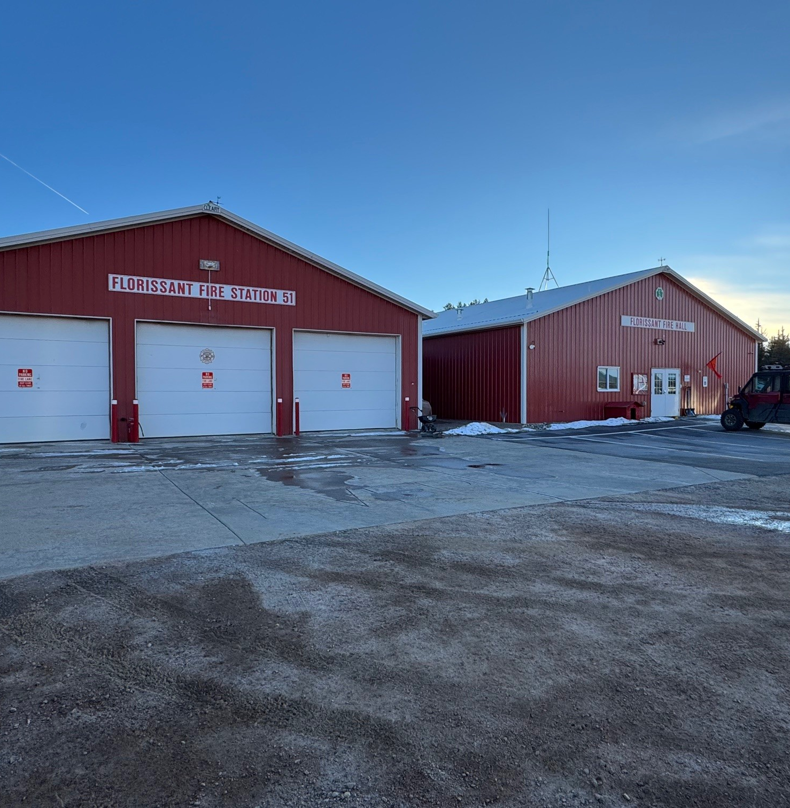
Station 51
The main bays, built in 1997, house three units and a small workshop. Door height limits vehicle specifications.
The Fire Hall, built in 2007, was remodeled in 2024/25 to better accommodate training, administrative, and community activities.
4 suppression units operate out of 3 lower bays
  T51: 1998 Int’l 6x4 with 3,500 gallons
  E51: 1992 Int’l 4x4 pumper with 900 gallons
  RE51: 2003 HME 2wd with 500 gallons
  UTV51: 2025 CanAm Defender with 85 gallons
3 non-fire units operate out of station 51
  Utility51: 2002 Ford F550 maintenance/plow/support
  Car51: 2024 Subaru Outback staff vehicle
  Rehab51: 2004 Ford F350XLT–FireCorps fire support
Station 51
and Fire Hall

Slide 5
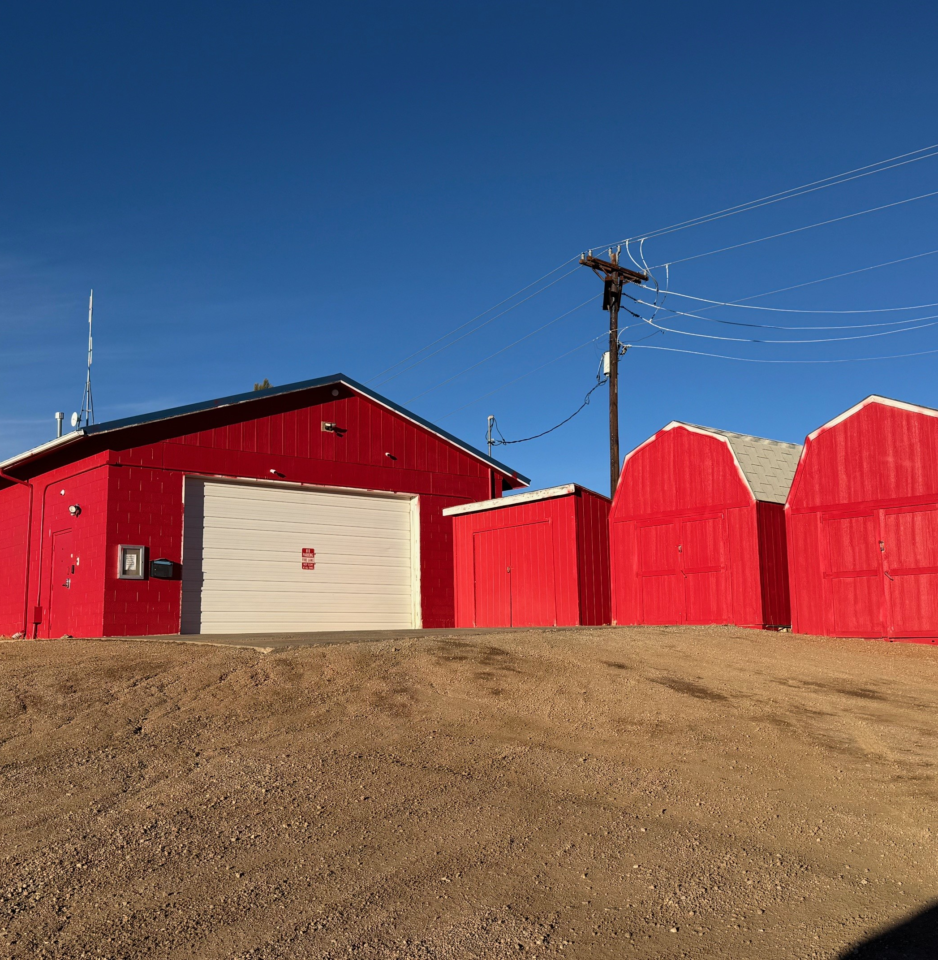
Station 51
Upper Bay
The upper bay, built in the late 1970’s, accommodates two smaller units.
The 2024/25 remodel added a small lounge and basic sleeping facilities for volunteers but it has a very limited “kitchen” and does not have a shower or laundry.
2 units operate out of the upper bay
  R51: 2008 Ford F550 with 300 gallons
  B51: 2009 RAM 5500 with 400 gallons
Wooden sheds serve as storage for PPE.
Station 51
Upper Bay / Sheds
Notes:
The cinder building is inefficient to heat. The sleeping quarters are often too cold for comfort in the winter. The “kitchen” consists of a refrigerator, sink, and microwave. There are no showers or laundry facilities at station 51.

Slide 6
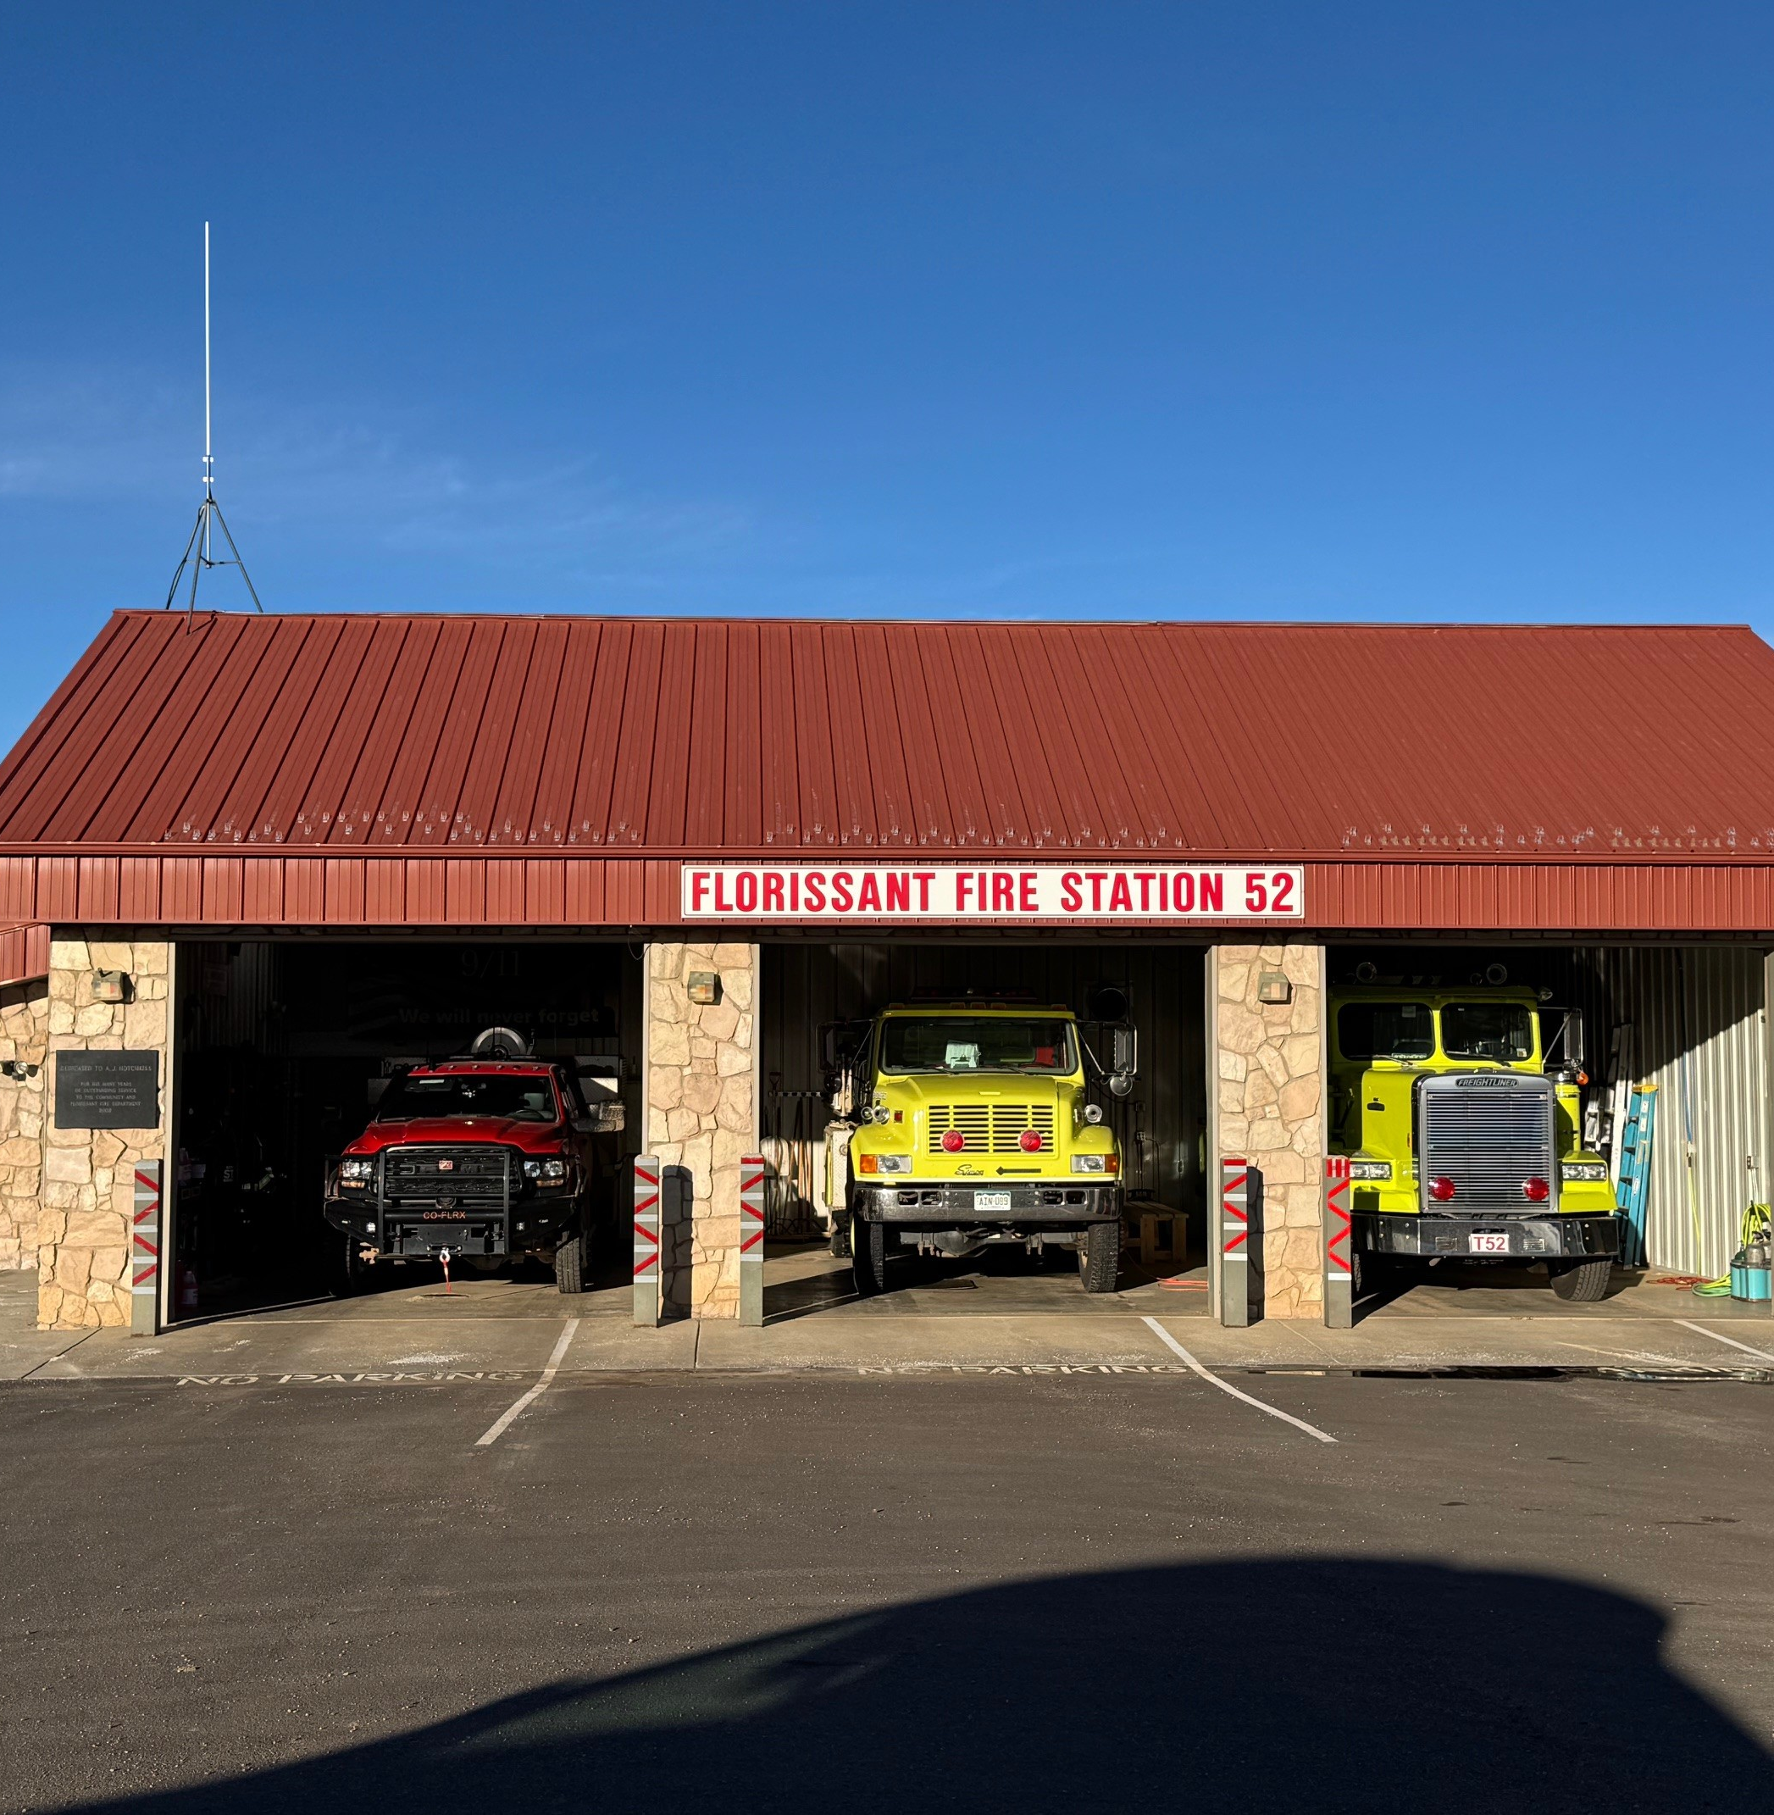
Station 52
Built in 2002
The driveway and landing zone were paved in 2025 to improve access and drainage during inclement weather
Recently reconfigured to meet ISO requirements that it house 4,000 gallons
3 units operate out of 3 bays
  R52: 2024 RAM 5500 with 409 gallons
  E52: 1999 pumper with 900 gallons
  T52: 1988 Freightliner with 3,000 gallons
Options for the configuration are limited by door size and depth of bays – no room for expansion or higher capacity vehicles.
Hosts the fuel moisture testing equipment
Station 52
Built in 2002
Notes:
In order for T52 to fit in the bay, we had to cut off 6 inches of the rear chute. T52 must also be full of water to fit inside the 10’ door. The rear of the tender must be against the rear wall. There is less than 2” to spare for the door to close.

Slide 7
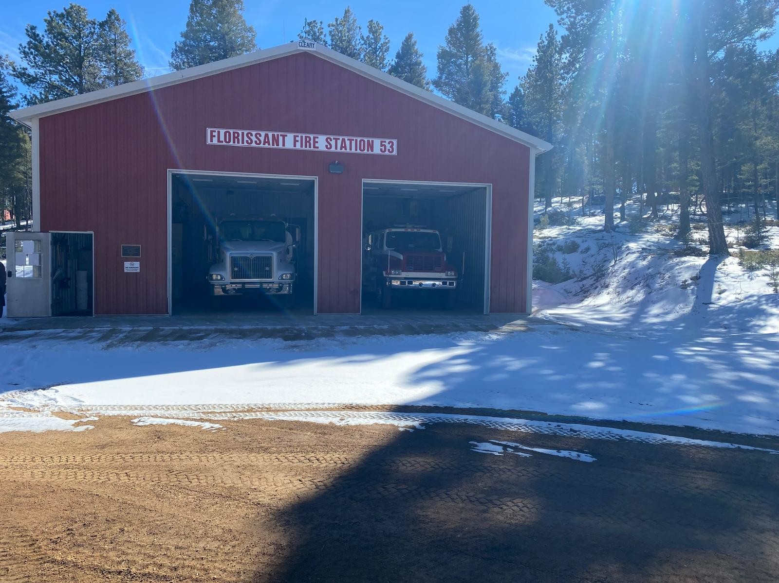
Station 53
Built in 2008
2 units operate out of 2 bays
  E53: 1992 International with 500 gallons
  T53: 2006 9200i Eagle with 4,000 gallons
1 unit in Indian Creek is not at Station 53
  B53: 2024 RAM 5500 with 250 gallons
Tender 53 has over 850,000 miles and is a 10-speed manual transmission which limits driver operators
Trees were recently cleared to make a more suitable landing zone but the surface is still dirt/mud/snow
Road access can be limited during inclement weather
Station 53
Built in 2008
Notes:
Brush 53 is assigned to Indian Creek but is not located at the station. The station can only accommodate 2 vehicles.
A contract to expand capacity at station 53 was cancelled in 2021 due to budget concerns. The cost for that project would be double the cost today.
We hoped to pave the helicopter landing pad in 2025 but it was stricken from the budget during planning.

Slide 8
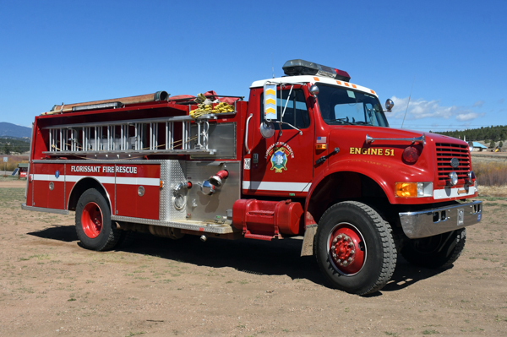
Vehicles
Our oldest apparatus was built in 1988. We currently have 6 units with over 100,000 miles. One unit has over 850,000 miles.
We only have five vehicles that were built in the last 15 years.
We currently have 12 units in our fleet of suppression apparatus.
Notes:
Units over 100,000 miles:
RescueEngine 51: 2003 with 122,353 miles
Engine 53: 1992 with 122,999 miles
Squad 52: 2001 with 124,369 miles
Rehab 51: 2004 with 216,341 miles
Tender 51: 1998 with 367,315 miles
Tender 53: 2006 with 856,673 miles
Other units over 15 years old:
Tender 52: 1988
Engine 51: 1992
Engine 52: 1999
Utility 51: 2002
Rescue 51: 2008
Brush 51: 2009
Newest units (1-2 years old):
Brush 53: 2024 (100% donation)
Rescue 52: 2024 (new vehicle outfitted with salvaged parts)
UTV 51: 2025 (pancake breakfast fundraiser)
Chief 50: 2024 (EMTS 50/50 grant)
Car 51: 2024 (100% donation)

Slide 9
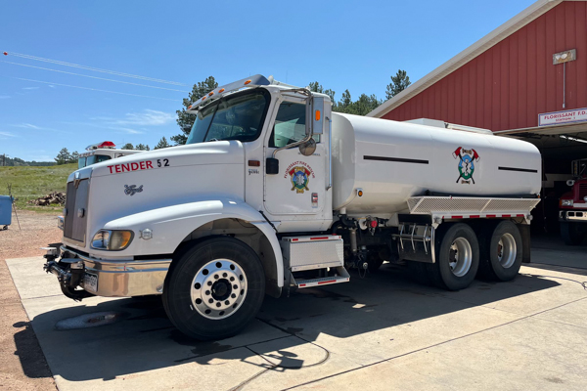
Water
Tenders
provide the water supply that is critical for rural fire suppression operations
We have 3 tenders – average age 28.7 years
2 tenders need to be replaced due to impending major repairs
A re-built tactical tender is on order but may not fit inside current bay doors
Water Tenders cost between $200,000-$400,000

Slide 10
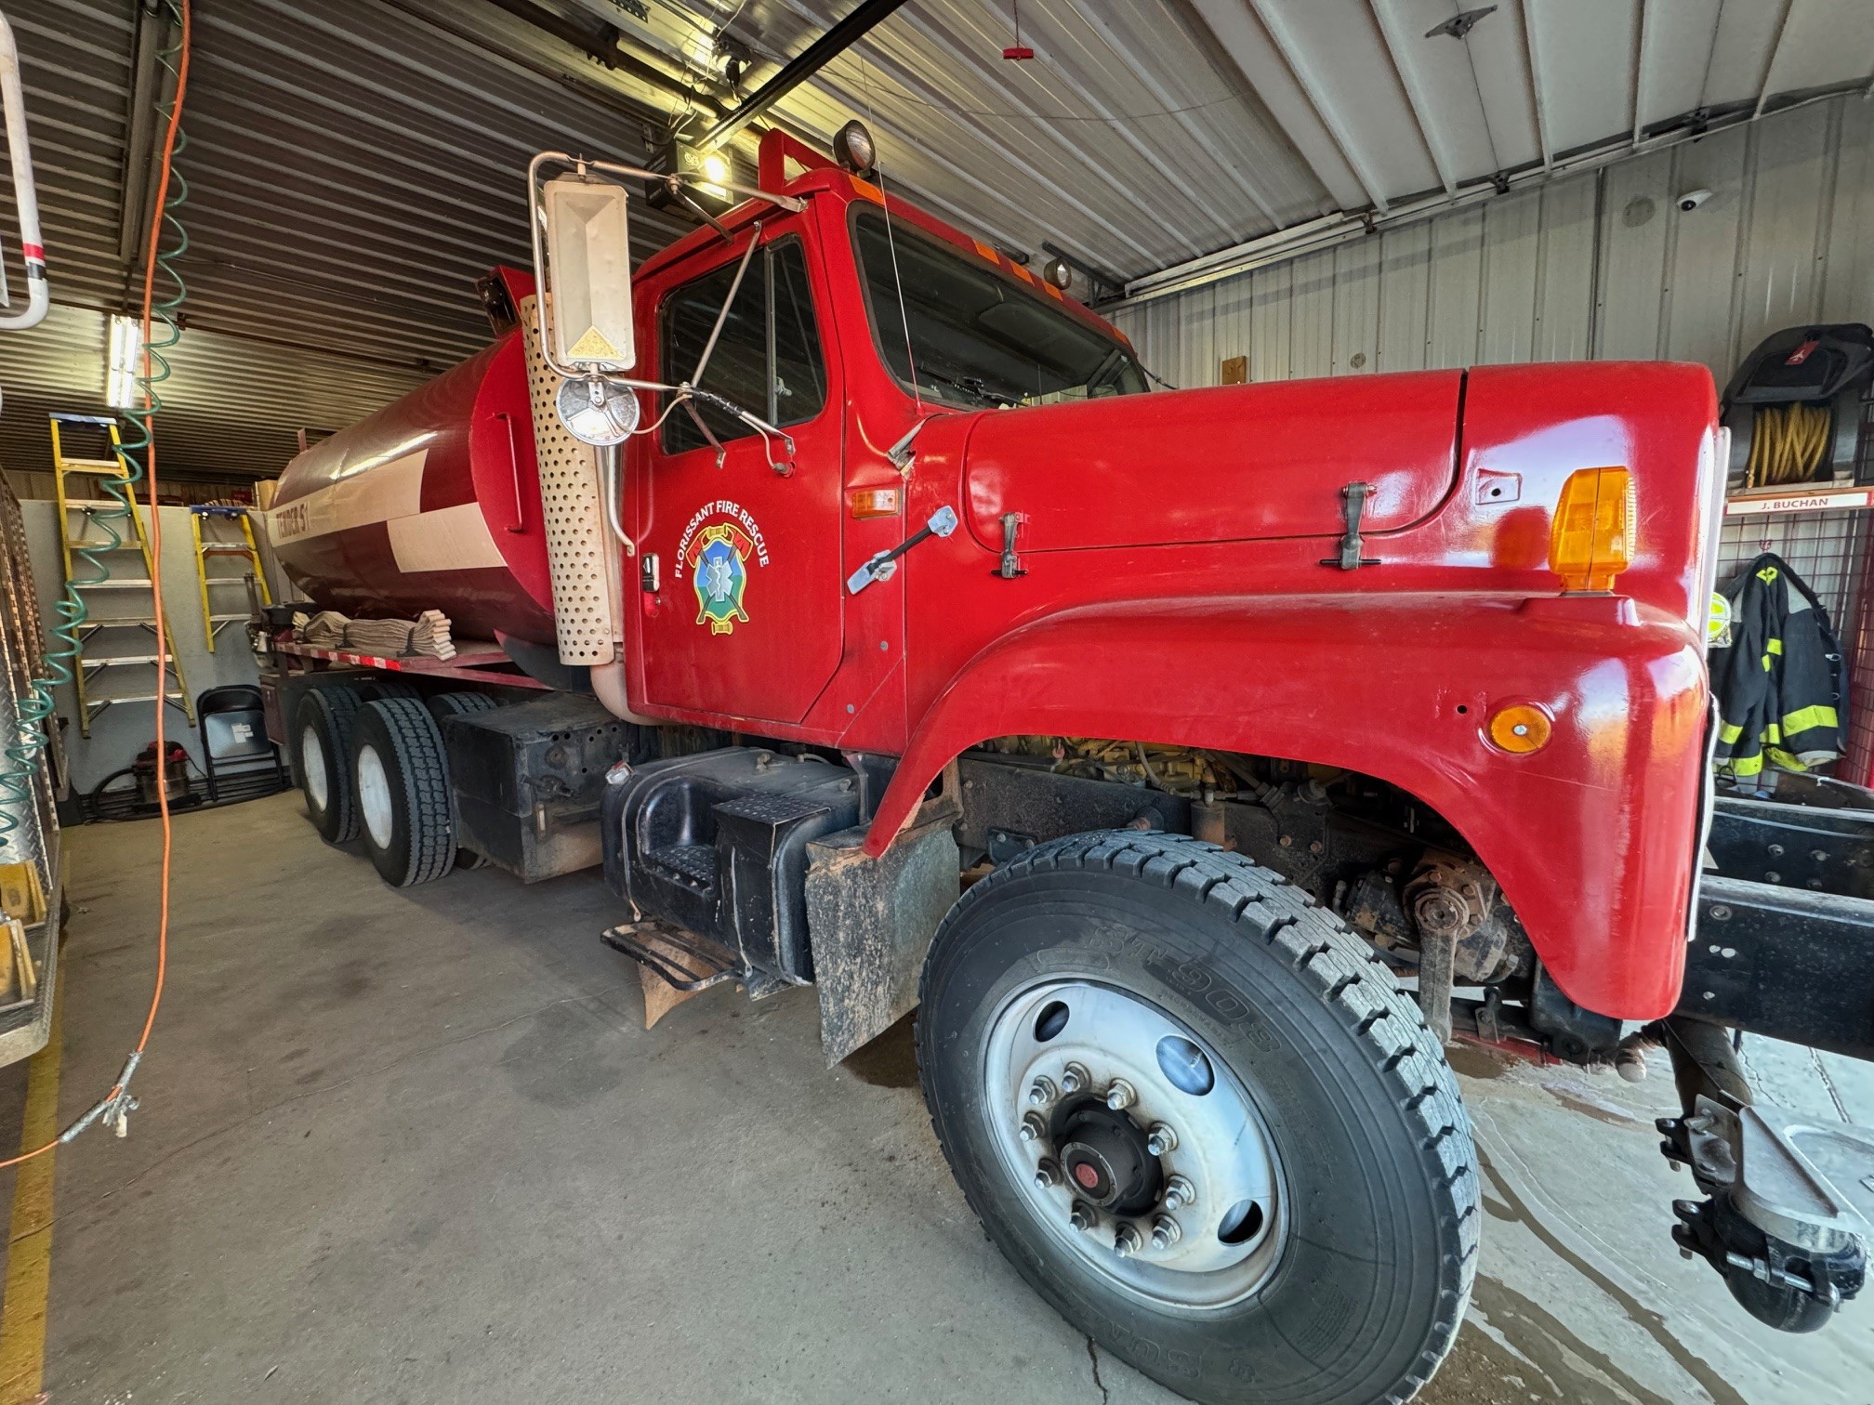
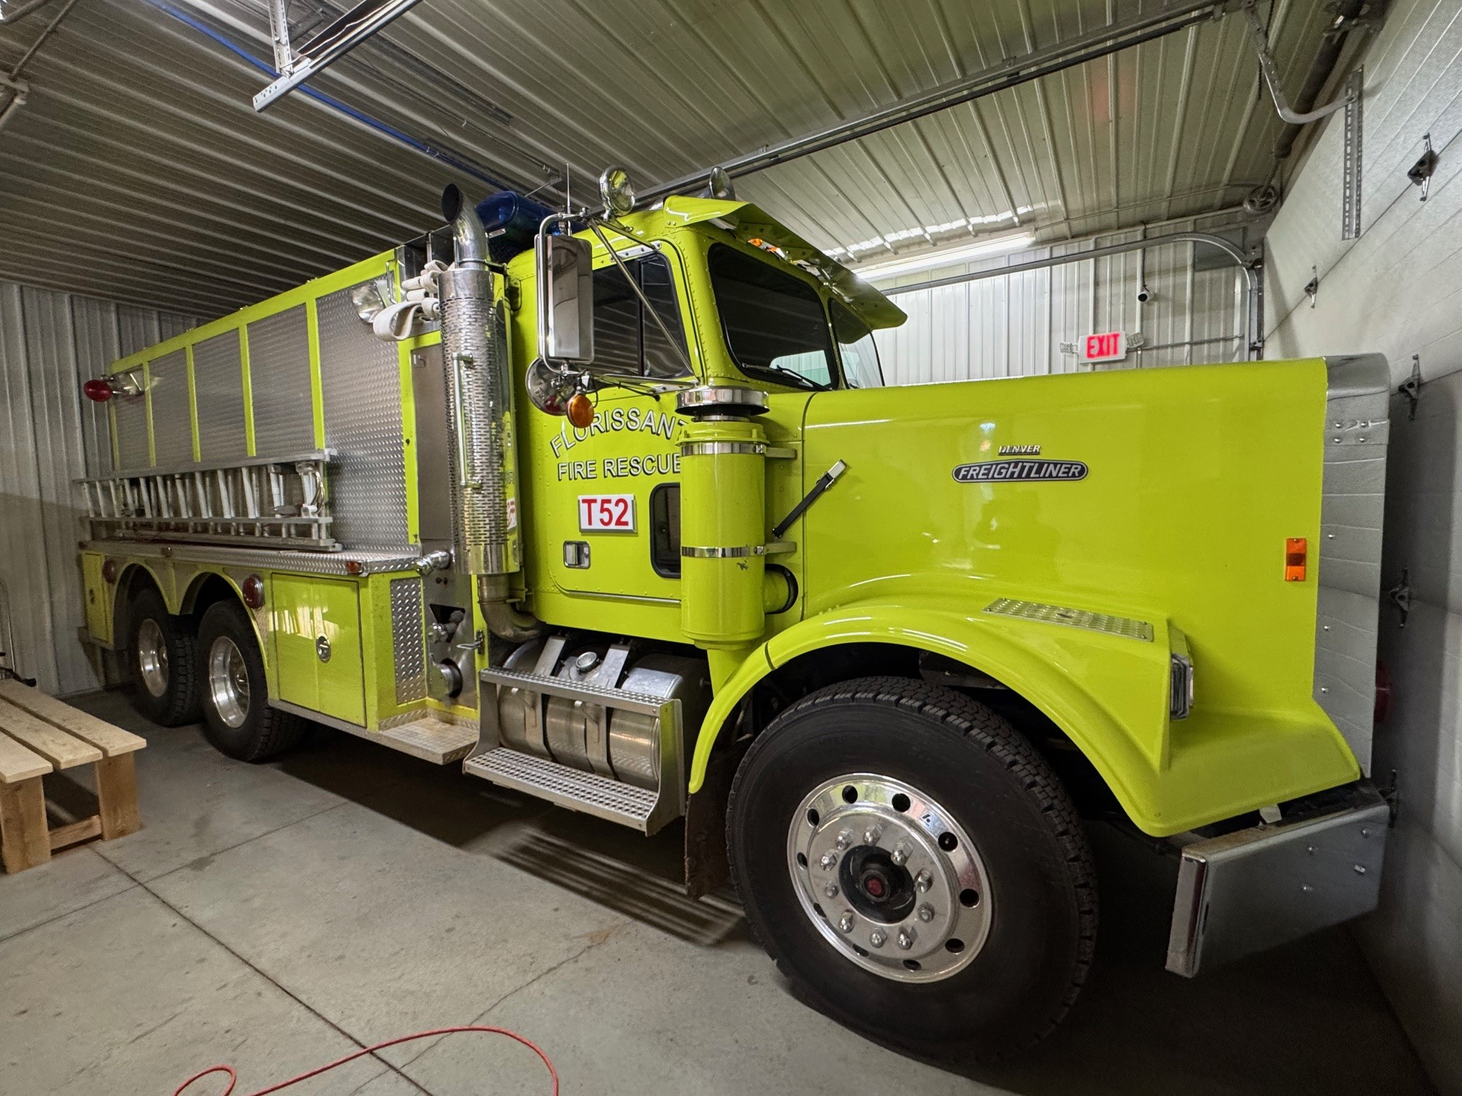

Tenders 51, 52, and 53
Notes:
Tender 51 was recently converted to a tactical tender but it has a frame issue that prevents it from passing inspections for deployment
Tender 52 is a 1988 Freightliner that was purchased from Evergreen Fire in 2025. Although is has low miles, it required some refurbishment. There is additional maintenance necessary to keep it fully in service. It is located at station 52 to meet ISO requirements to house 4,000 gallons of water at the station. It will only fit inside the bay when it is completely full of water. It must be parked against the rear wall which allows less than 2” clearance for the bay door to close.
Tender 53 is a 2006 with over 850,000 miles on it. It is a 10-speed manual transmission with limited qualified driver operators. At its last PM test, we were warned that it probably has limited life left.

Slide 11
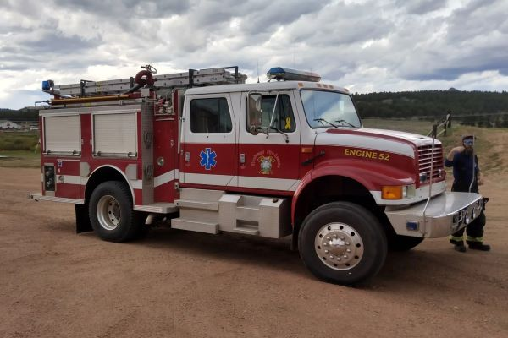
We have not purchased a new fire engine since 1999.
Then the unit cost $145,000. Today that same unit cost $460,000
We need to purchase 3 engines over the next 8 years.
Fire
Engines

Slide 12
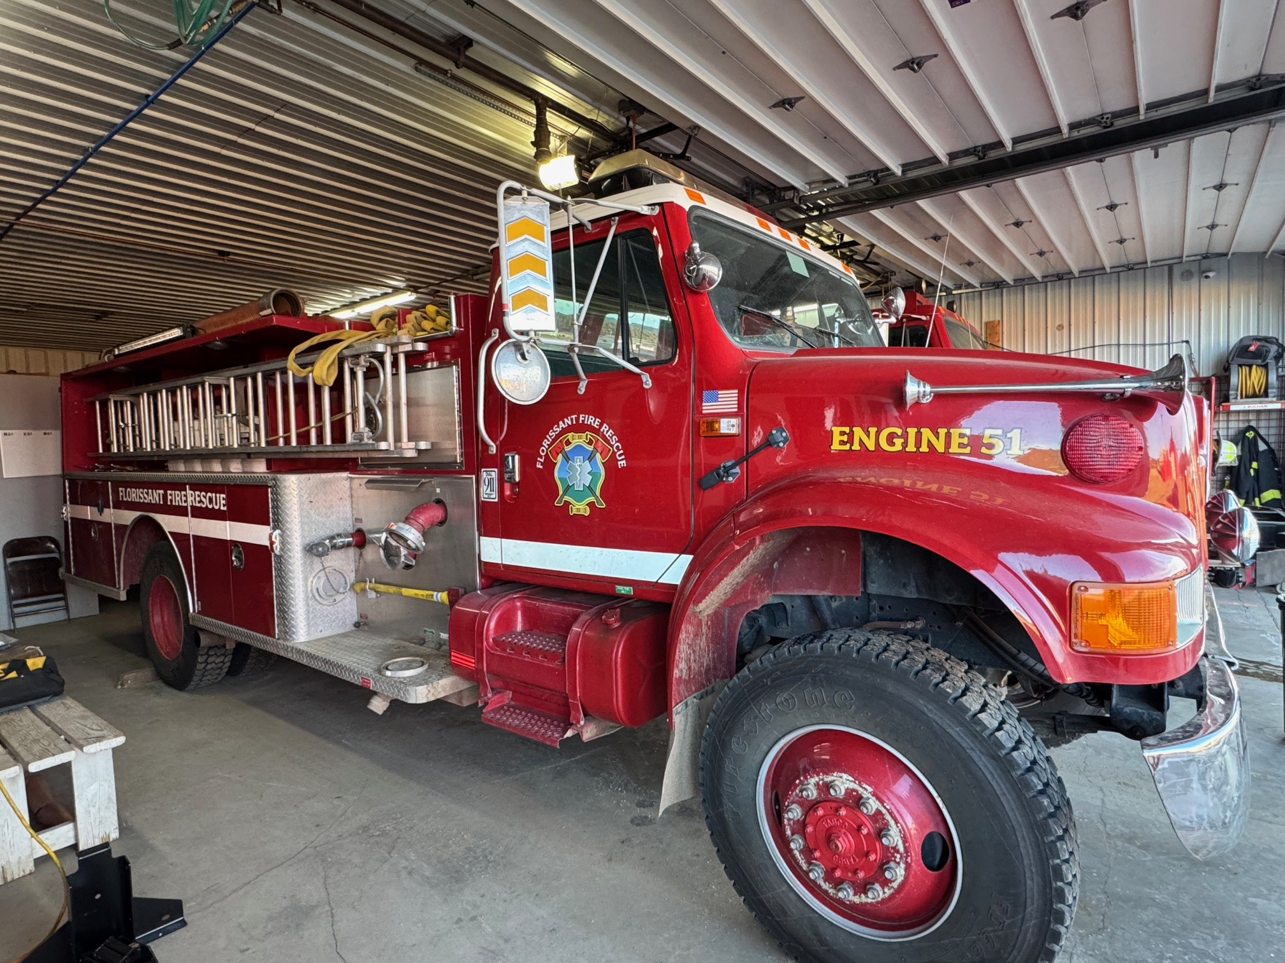
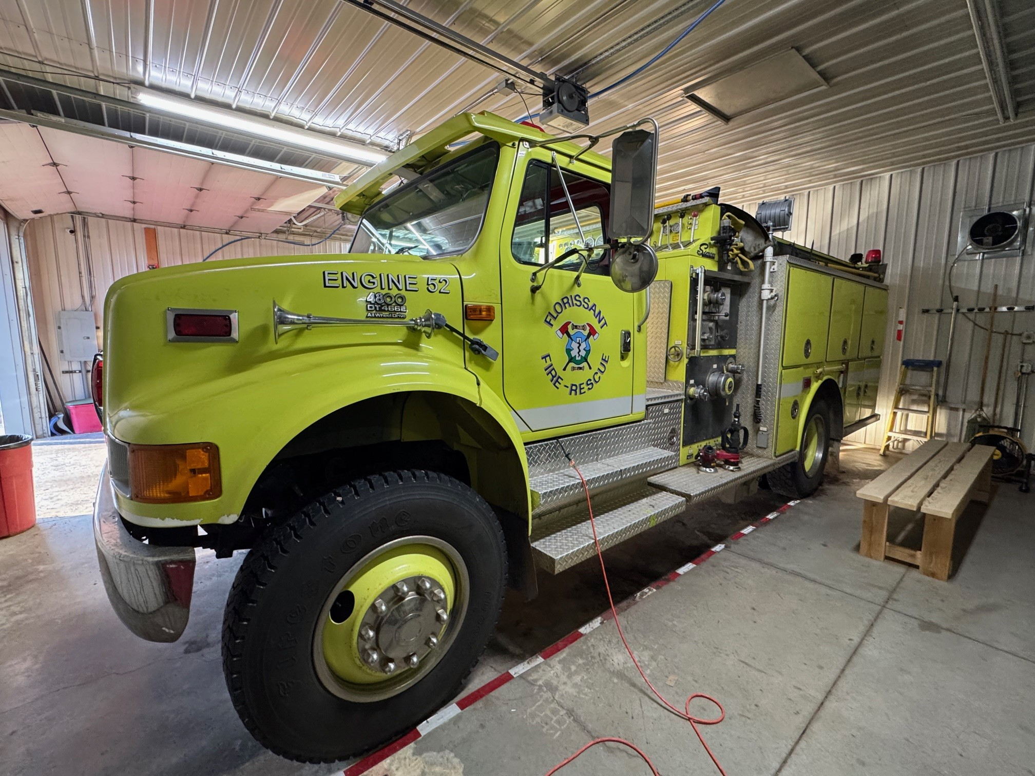
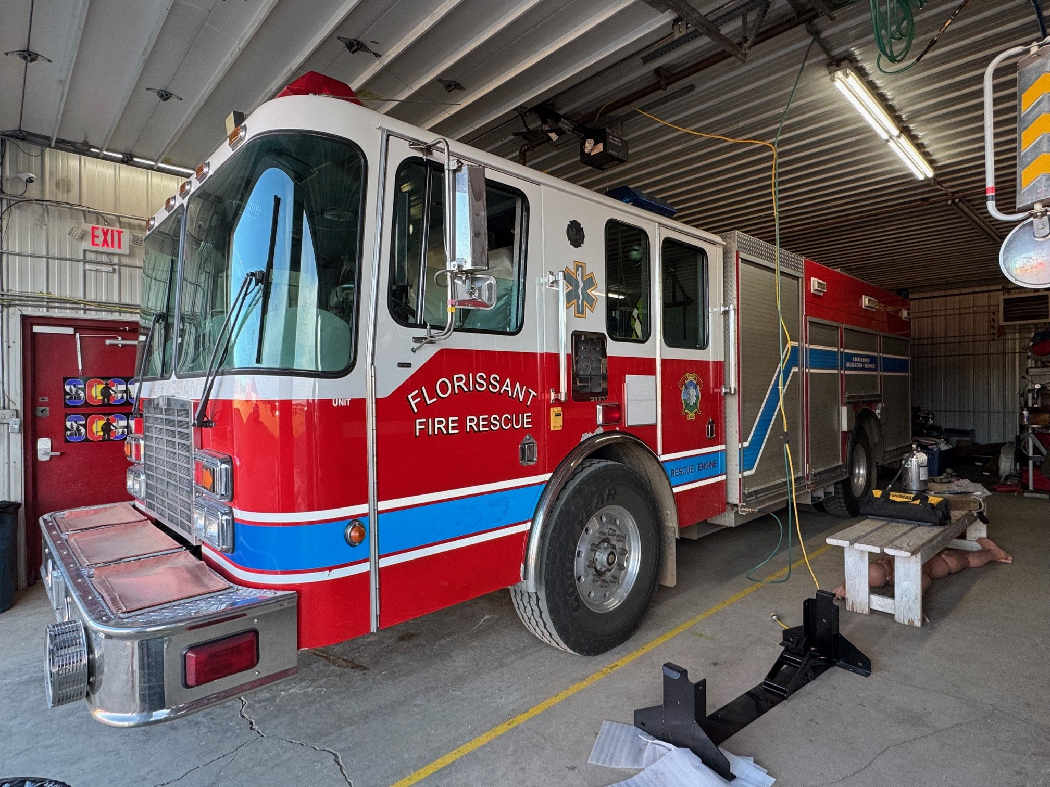

Engines 51, 52, 53, and RE 51
Notes:
Engine 51 is a 1992 pumper. Seating is limited to 2 responders.
Engine 52 is a 1999 pumper. Seating is limited to 2 responders. It was moved to station 52 because it has a larger water capacity to meet ISO requirements.
Engine 53 is a 1992. It is our only 4x4 engine with seating capacity greater than two, however it only carries 500 gallons water and has persistent problems with leaking valves. Its sister engine was sold a couple years ago because replacement parts were no longer available.
Rescue Engine 51 is a 2003. It has seating capacity for 4 but only carries 500 gallons water and is a low clearance 2 WD that is not suitable for service on many of our dirt roads and driveways. It is primarily used for motor vehicle accidents on paved roads.

Slide 13
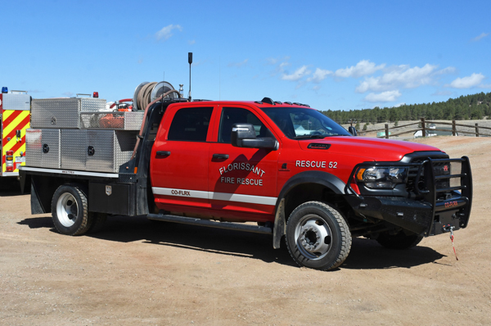
Brush and Rescue
Units
Type 6 / Rescue vehicles used for outside/wildland fires, first response vehicles, and auto accidents
In 2024 we built this unit for just under $100,000 using parts from a retired unit. We will need to replace one unit and add two other units in the next 2-5 years. The cost in today’s dollars will be around $150,000 each.
Notes:
Rescue 51 will need to be replaced.
Two additional Brush trucks necessary but there is nowhere to store them until additional bays are constructed.

Slide 14
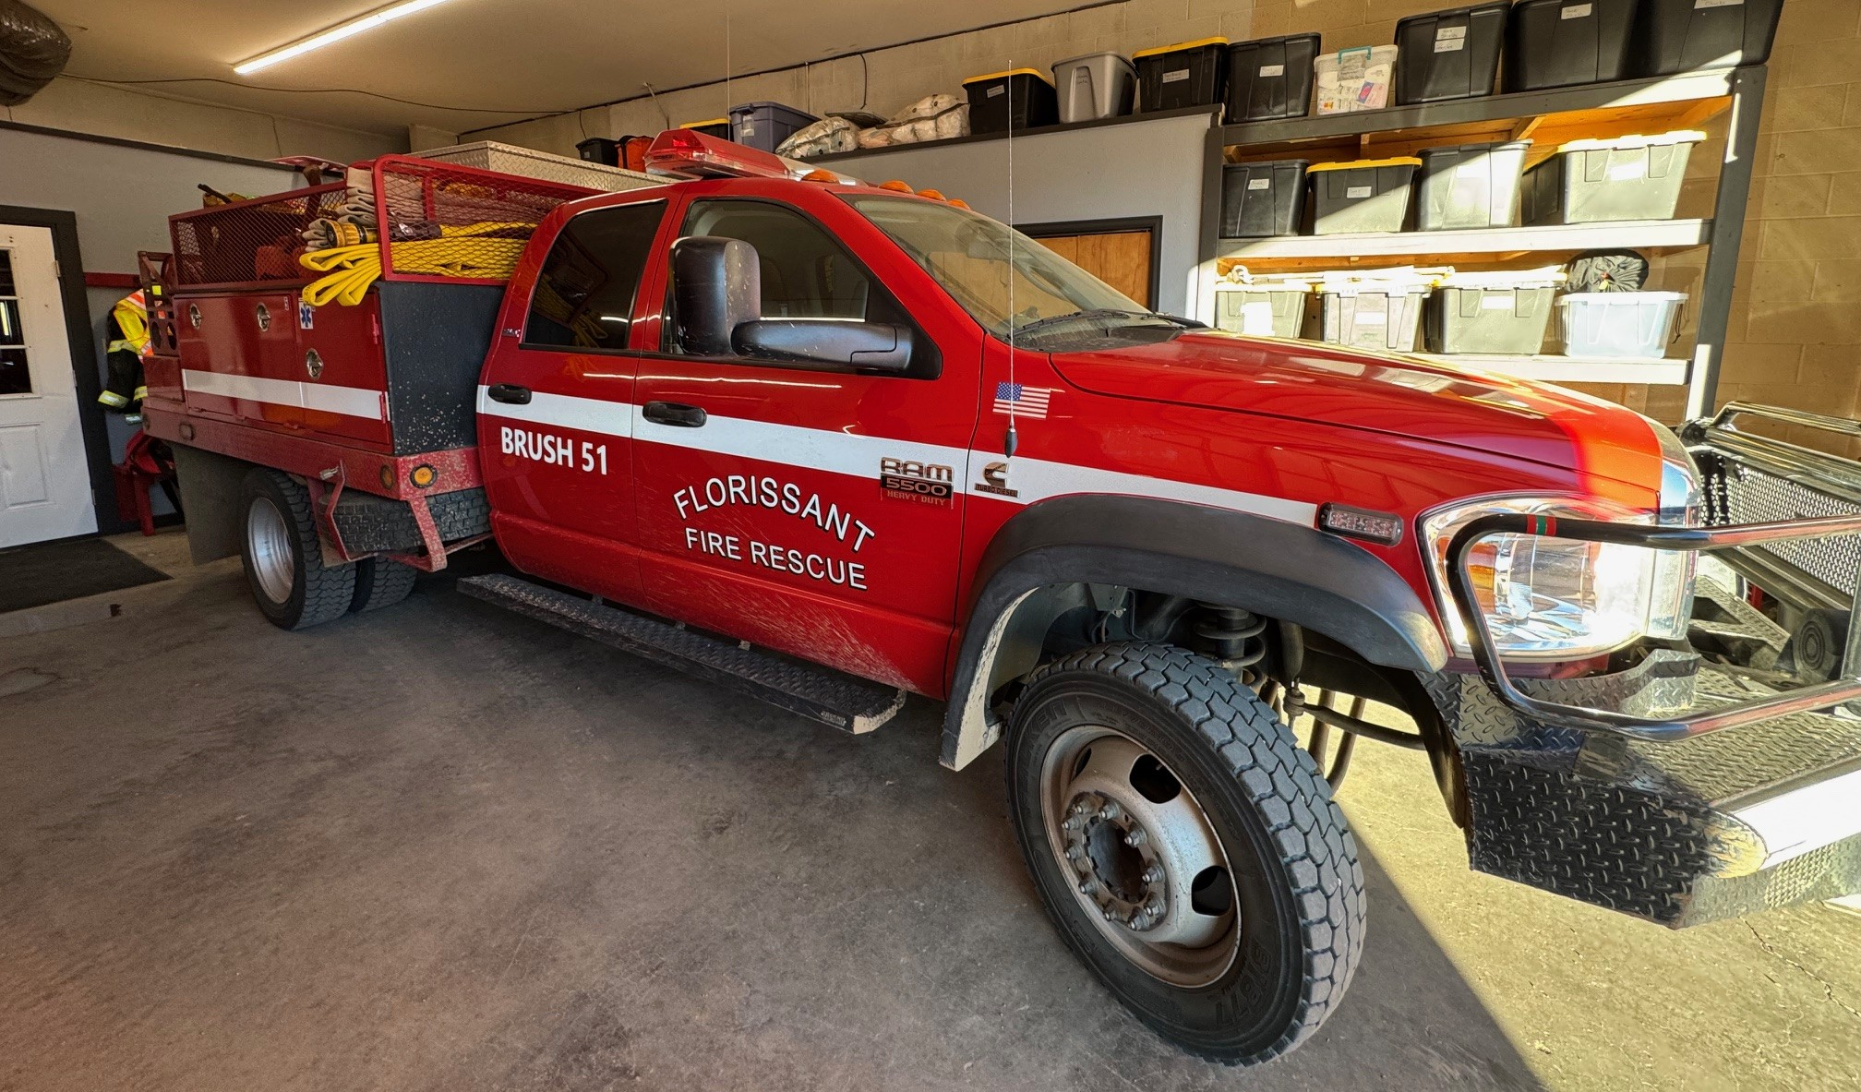
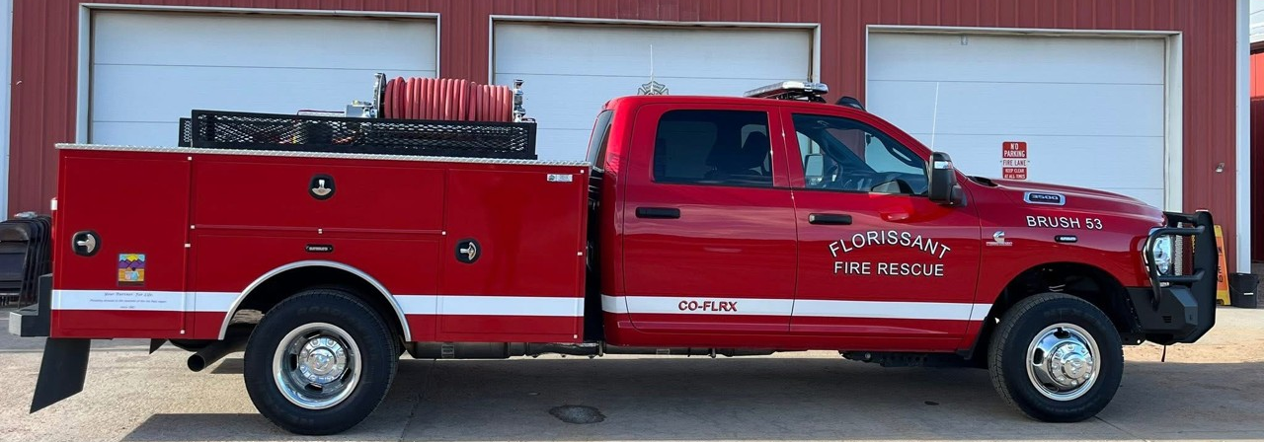
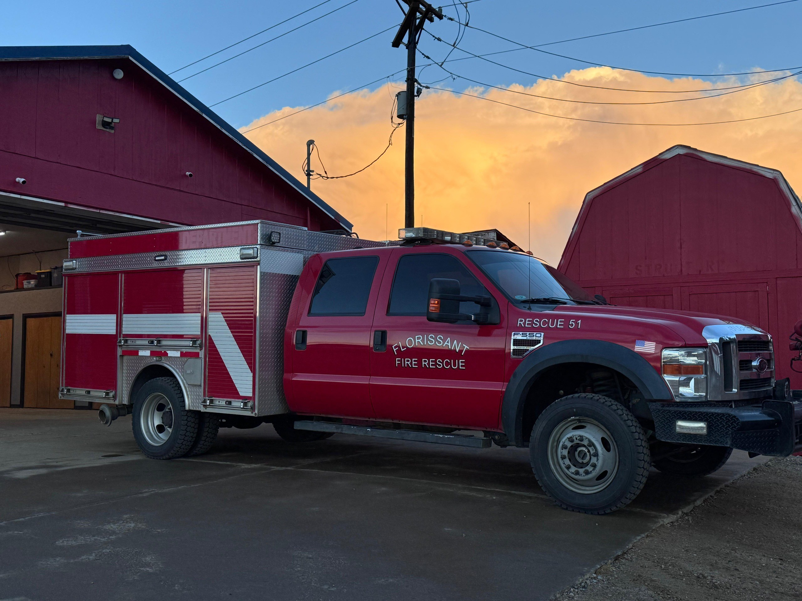

Brush 51, 53 and Rescue 51, 52
Notes:
Brush 51 is a 2009 RAM 5500. It is our most used Brush truck – ready for deployments.
Brush 53 is a 2024 RAM 3500. It is our newest brush truck - acquired in 2025 thanks to a 100% donation. It is assigned to Deputy Chief Moon for direct response out of Indian Creek.
Rescue 52 is a 2024 RAM 5500. The bare vehicle was acquired new in 2024 and then outfitted as a rescue/type 6 using parts salvaged from another decommissioned vehicle.
Rescue 51 is a 2008 Ford F550. It was purchased used in 2023. It has had persistent maintenance problems including over $26,000 of repairs in 2025.

Slide 15
Other Vehicles
Direct Response, Service Vehicles, and Staff Vehicles
Chief 50 and Sqd 52 serve as direct response vehicles.
Sqd 51 is out of service.
Sqd 51 & Sqd 52 are due to be replaced in 2026.

Slide 16
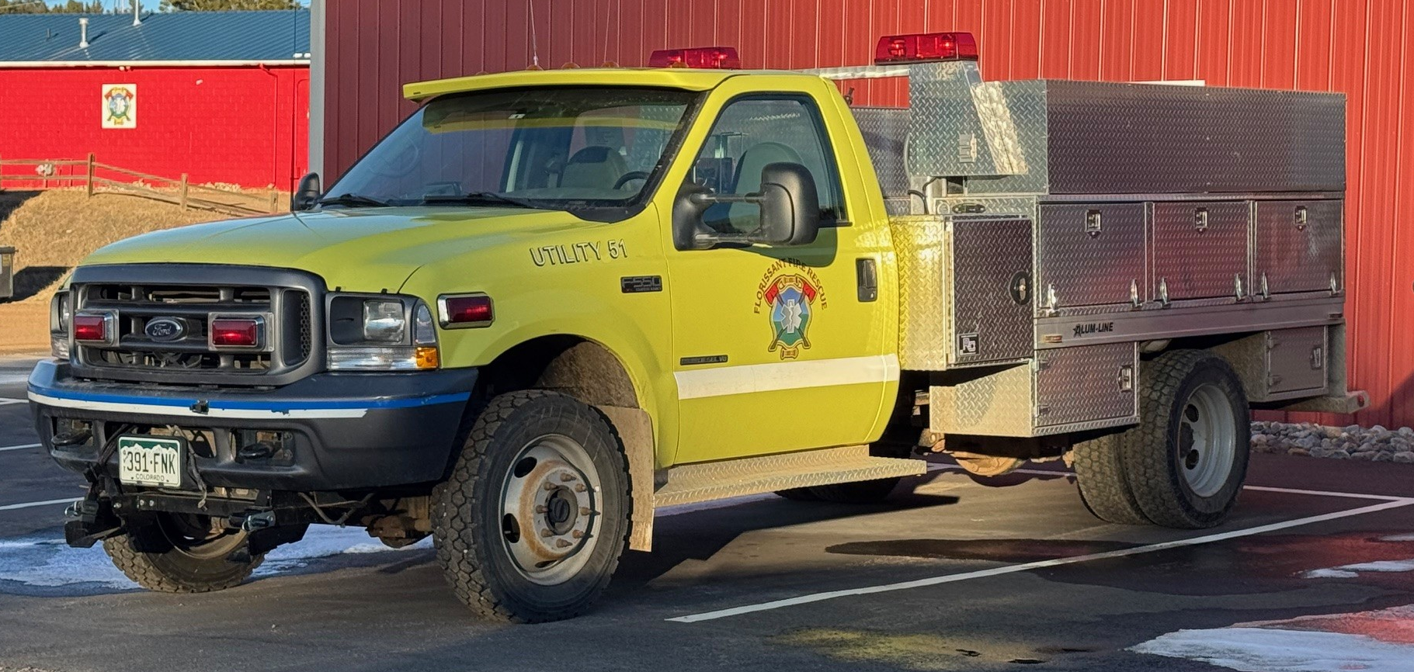
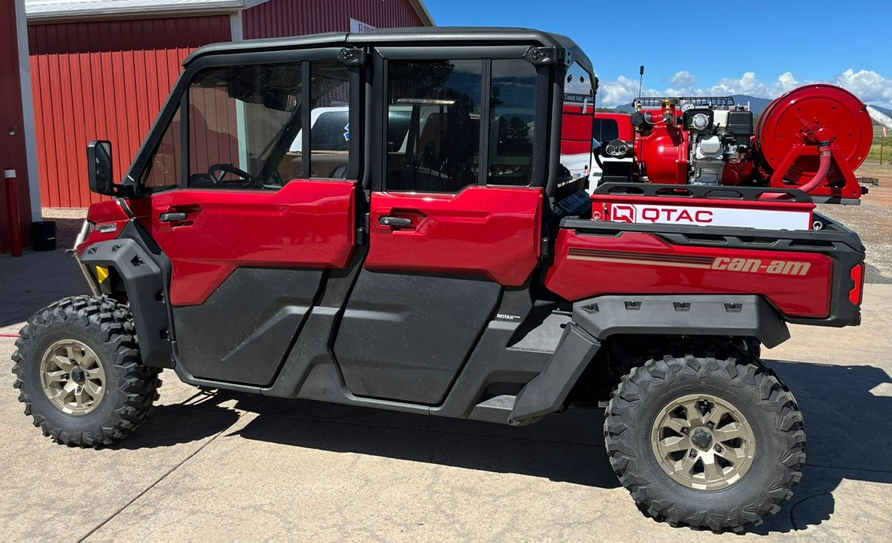
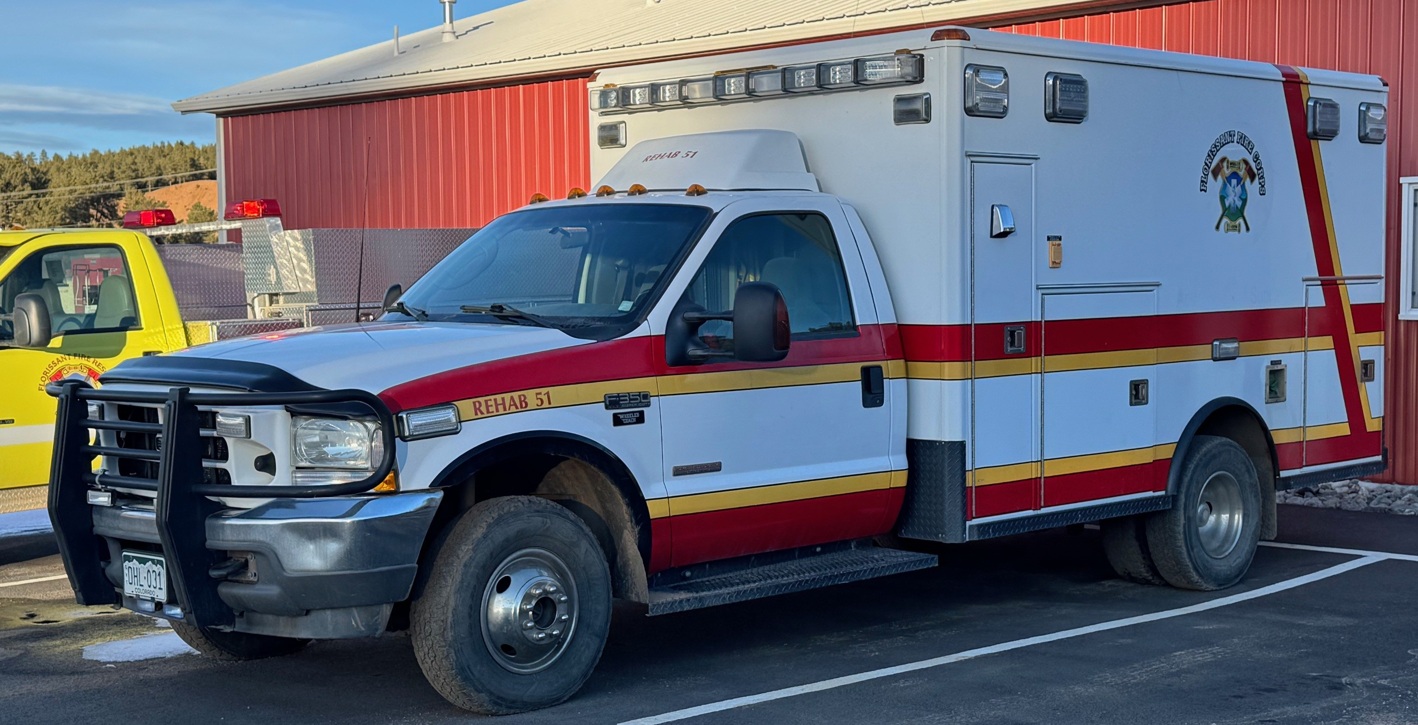
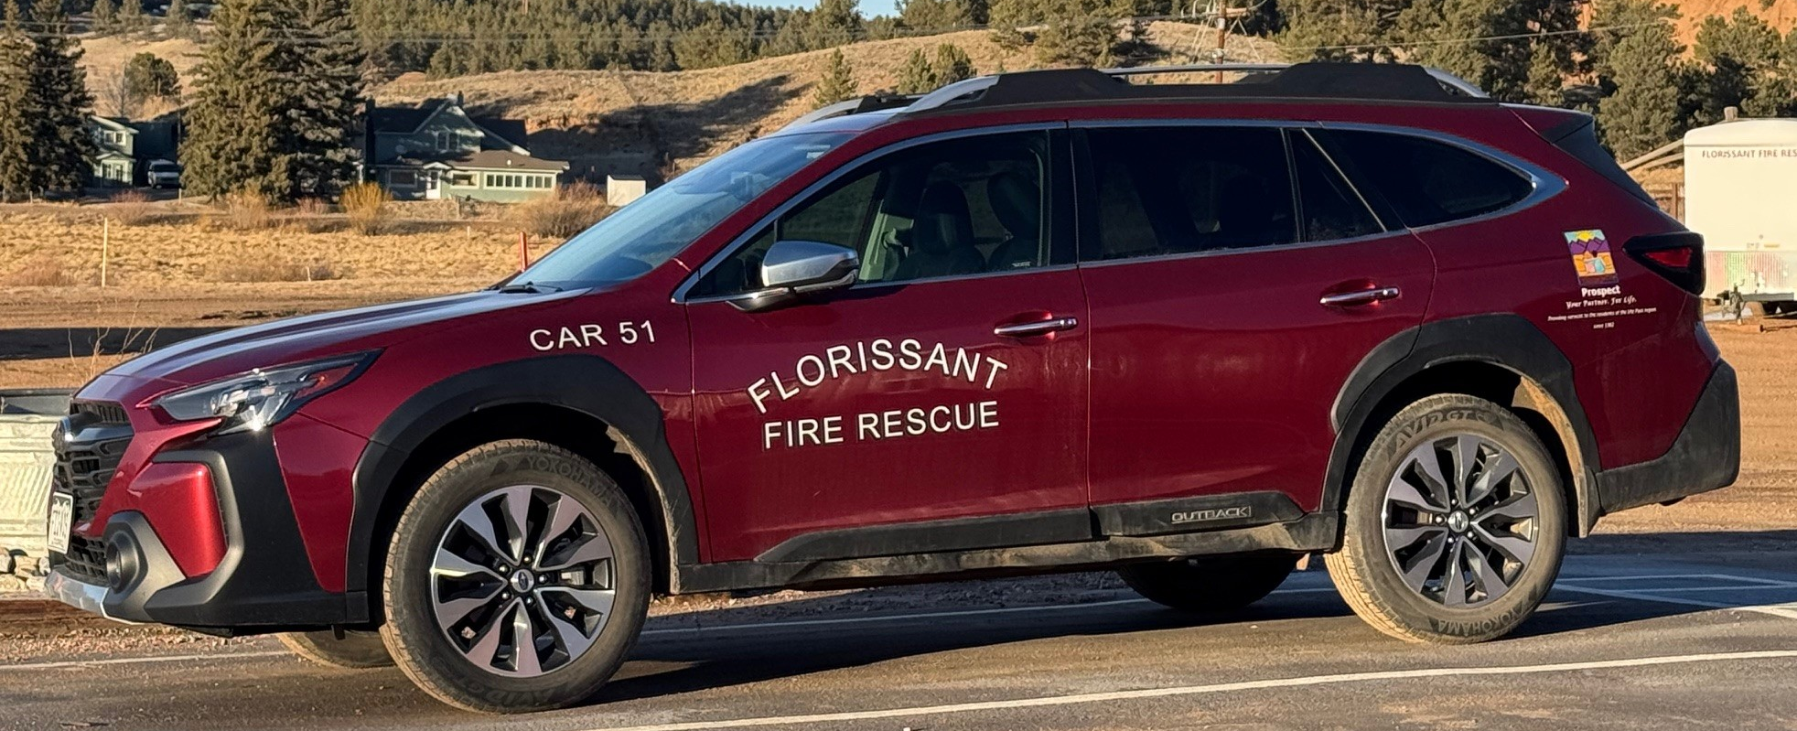
Utility 51, UTV 51, Rehab 51, Car 51
Notes:
Utility 51 is a 2002 Ford F550 that was converted in 2025 from a box style rescue vehicle to a utility vehicle using donated parts and labor. The plow from the old decommissioned U51 was also moved to this vehicle.
UTV51 is a 2025 CanAm Defender MAX with a QTAC 85 EMS-C. It was purchased with funds raised from the pancake breakfast. The UTV is used to access off-road wildfires.
Rehab 51 is 2004 Ford F-350XLT – decommissioned ambulance purchased from UPRAD. It is used by Fire Corps to deliver food and supplies to extended wildfire and structure fire incidents.
Car 51 is a 2024 Subaru Outback. It was purchased with 100% donated funds. It is used as a staff vehicle for travel to training, administrative errands, fuel moisture testing, and shopping for event supplies. It has also been used to transport additional responders to incidents. Car51 provides a more efficient means of travel for department personnel without taking a first response vehicle out of service or outside the district.

Slide 17
Other Infrastructure, PPE and Training

Slide 18
Fire Hydrants
The town of Florissant carries a better ISO rating because of the availability of water via fire hydrants. Still, there is room for improvement by decreasing the distance to a hydrant for all residents. An additional fire hydrant was added during construction on the Crystal Peak tank in December 2025. An additional 7 fire hydrants are planned in the next year at a cost of $100,000.

Slide 19
Backup Generator
Station 51 houses the administrative offices and serves as a community evacuation center during emergency incidents.
Power companies are beginning to adopt rolling power outages to lessen risk of outside fires during severe weather events.
A backup generator is necessary to ensure continuity of operations.
Notes:
Cost is expected to be around $20,000 - $30,000. We are hoping to raise funds to accomplish this project in 2026.

Slide 20
Rising Costs
Since 2020, recurring costs for fire services activities have increased 15% per year.

Slide 21
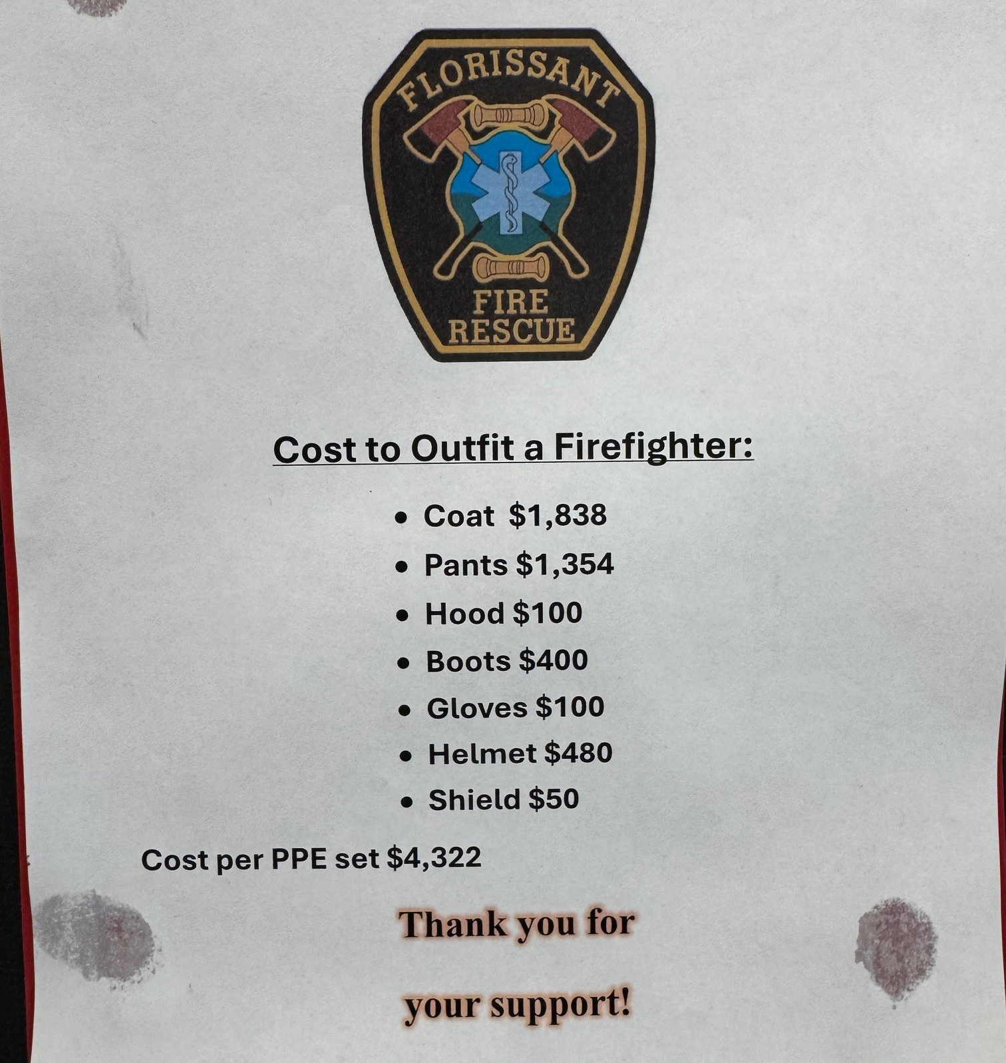
Firefighter PPE & Training Cost
  Wildland Firefighter Certification $500
  Wildland PPE $1,350
  Structure Firefighter Certification $ 2,000
  Structure PPE $4,322
  SCBA w/ mask $12,100
  Radio $2,000
  Light and Other Safety Equipment $750
  Other Certifications $1,000
TOTAL COST PER FIREFIGHTER $24,022

Slide 22
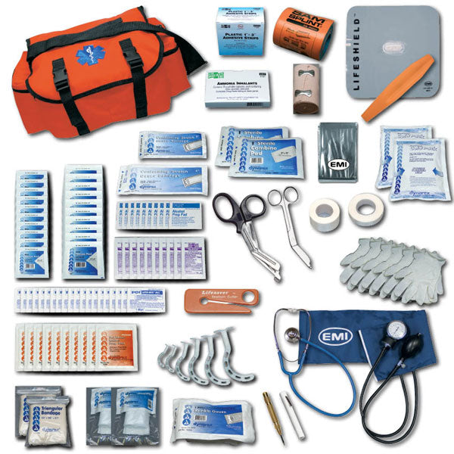
Rising Costs
Since 2020, recurring costs for EMS activities have increased 33% per year.
Cost for EMS Training $2,000 per Person

Slide 23
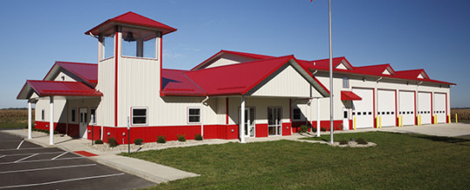
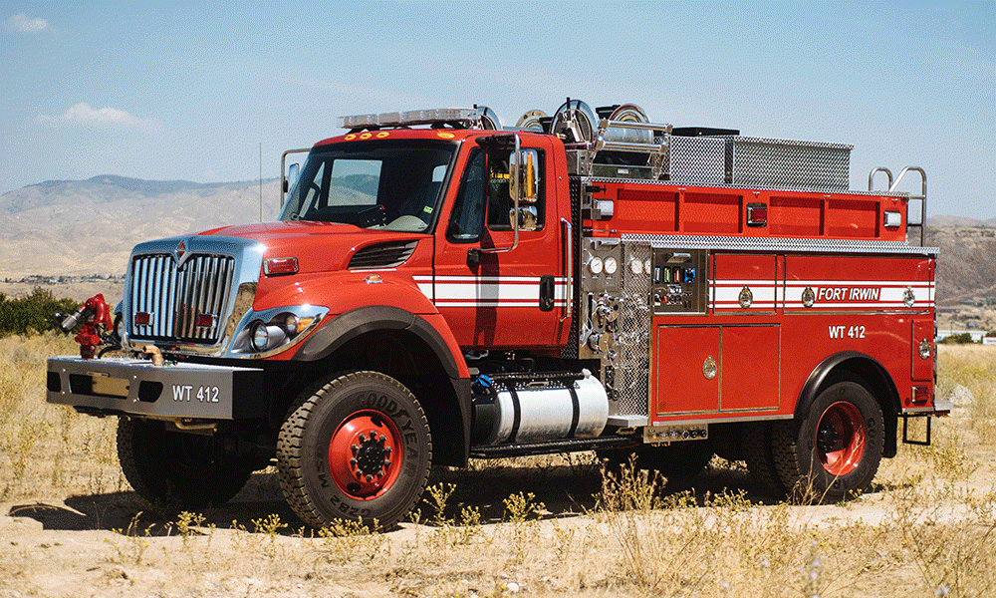
What's The Plan
The district needs to build a new main fire station with larger and additional bays in the next 2-3 years.
Cost $800,000-$900,000
The district needs to replace or add
8 fire apparatus in the next 8 years.
Cost $2,430,000

Slide 24
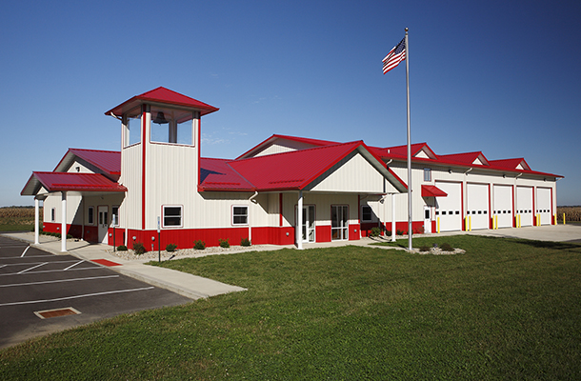
Year 1 -2 2027-2028
Phase 1 Outer Shell Apparatus Bay $400,000 Later - Phase 2 Living Area $400,000
Fire Station Construction

Slide 25
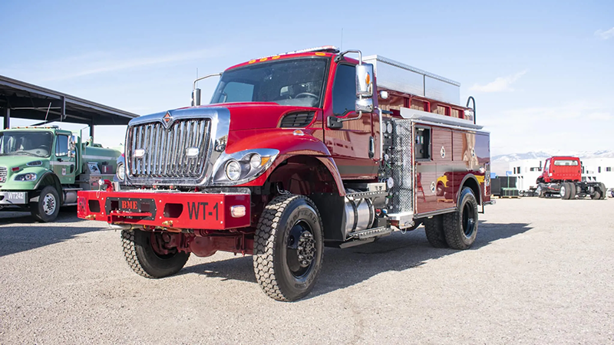
Year 2-3 2028-2029
Replace two Tenders
Cost if Purchased Today: $400,000 New $200,000 used
Notes:
Tender 51: 1998 with 367,315 miles has issues with the frame
Tender 53: 2006 with 856,673 miles has impending catastrophic issues with the transmission and has limited qualified driver operators

Slide 26
Year 3 & Beyond 2029-2035
Replace three Engines / Rescue 51
Add two Type 6 Brush trucks
Cost if Purchased Today: $150,000 - $460,000 each
Notes:
Replace:
Engine 51: 1992 pumper. 34 years old. Seating is limited to 2 responders.
Engine 53: 1992 with 122,999 miles. 34 years old. Only carries 500 gallons water. Has persistent problems with leaking valves. Its sister engine was sold a couple years ago because replacement parts were no longer available.
Rescue 51: 2008 Ford F550. It was purchased used in 2023. It has had persistent maintenance problems including over $26,000 of repairs in 2025.
Engine 52: 1999 pumper. Seating is limited to 2 responders. Replace for everyday use but may keep as a backup 4th engine.
Add:
two additional Type 6 Brush trucks

Slide 27
Revenue Options
Grants, Donations and Fundraising can no longer support a fire district of our size and the area’s growth. Borrowing money costs the taxpayers more in the long run and can cripple a small fire district. Capital assets require long term planning and funding. A plan should have been put in place 5-10 years ago for the continued success of the district. Every year of delay means added costs to meet the needs of the growing community.
Taking action now can prevent higher costs for the district and its citizens.

Slide 28

What Is The End Result ?
Our first goal is to be an ISO Class 3 Fire District. (District-Wide)
We want to lower the premiums for our property owners.
We want to get those who have lost insurance, covered again.
We are currently a Class 5/9 fire district.
Water availability is a critical component of the ISO ratings.
Our second goal is to provide an average response time of less than 10 minutes for all emergencies.

Slide 29
Questions
Fire Chief John Buchan
719-494-3874
Chief.buchan@florissantfire.com

